Slide 1
4 Online Workshops on the INSPIRE-Soil GeoPackage
The INSPIRE-SOIL GeoPackage has been produced by
Andrea Lachi, Giovanni L’ Abate, Maria Fantappiè [CREA, Council for Agricultural Research and Economics of Italy] with the support of Stefania Morrone [Epsilon Italia srl].

Slide 2

4th Workshop INSPIRE-SOIL Geopackage implementation and extension, through the connection to existing registries of (soil) vocabularies (Codelists) and other basic principles of ontology.
Basic introduction to: INSPIRE Soil Geopackage model - Observation&Measurements (O&M) - Codelists & Ontologies - The LUCAS Topsoil dataset - Population sequence. Held by Giovanni L’Abate
The INSPIRE-SOIL Template with LUCAS properties has been populated by Filippo Rocchi
with the support of Elena Tondini, Nadia Vignozzi, Giuseppe Valboa, Roberta Pastorelli, Stefano Mocali
[CREA, Council for Agricultural Research and Economics of Italy] within project CSI100K, sponsored by MASAF.

Slide 3
Outline
11:05 -11:15
11:15 – 12:05
12:10 – 13:00
First workshop wrap-up
The INSPIRE SO GPKG
Geopackage implementation and extension with LUCAS Topsoil data
Mentimeter results
Lesson learnt
11:15 – 11:45
INSPIRE Soil Geopackage model
Observation&Measurements (O&M)
Codelists & Ontologies
11:45 – 12:05 Q&A
12:05 – 12:10 Coffee break
12:10 – 12:40
The LUCAS Topsoil dataset
Population sequence
12:40 – 12:50 Q&A
12:50 – 13:00 Mentimeter

Slide 4
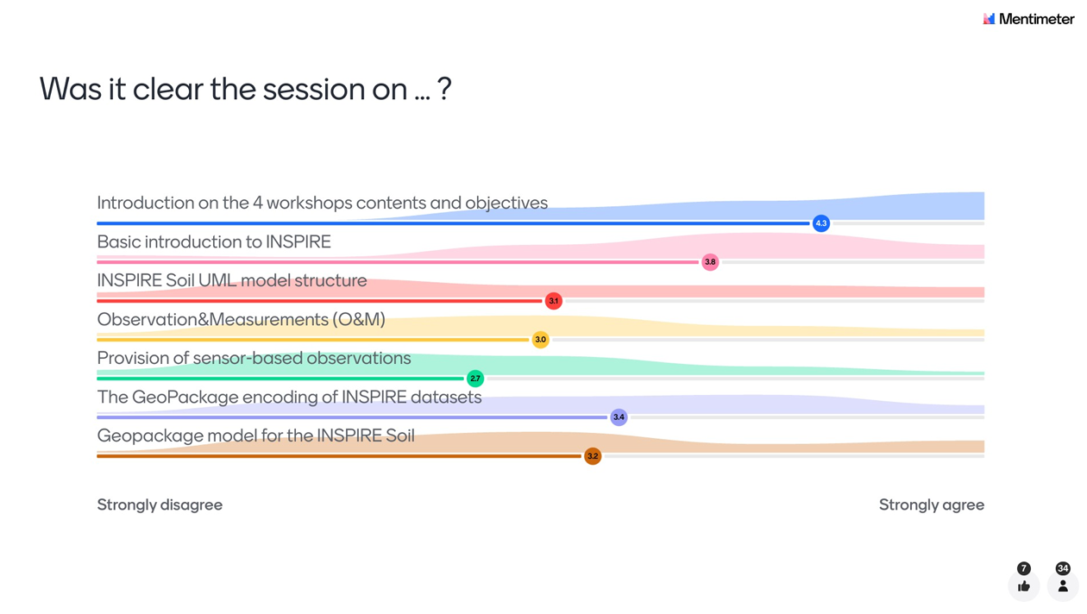


SOME RESULTS FROM THE MENTIMETER AT FIRST WORKSHOP

Slide 5
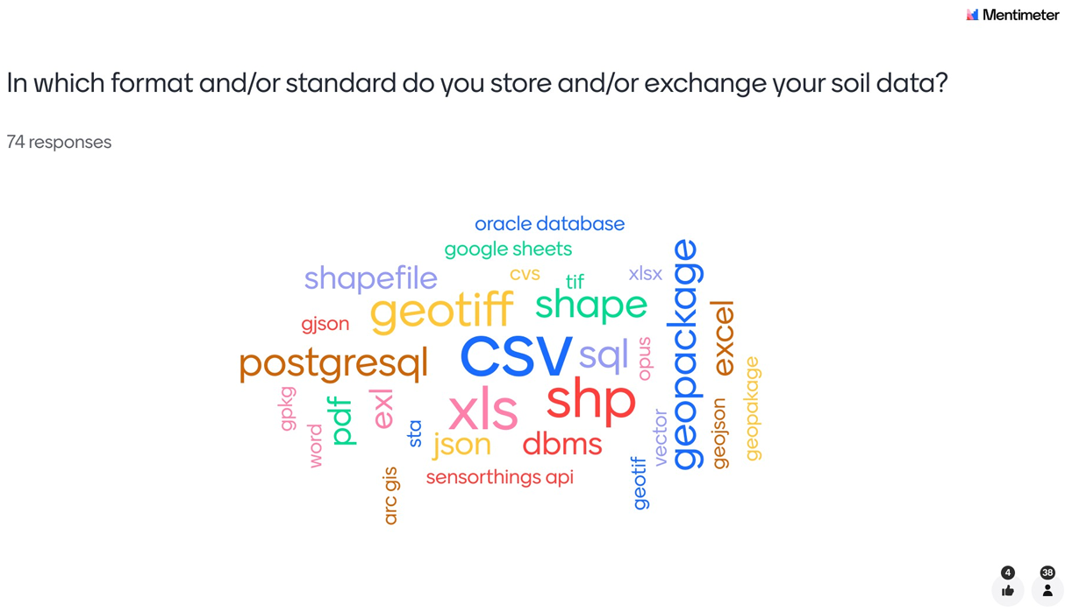
SOME RESULTS FROM THE MENTIMETER AT FIRST WORKSHOP

Slide 6
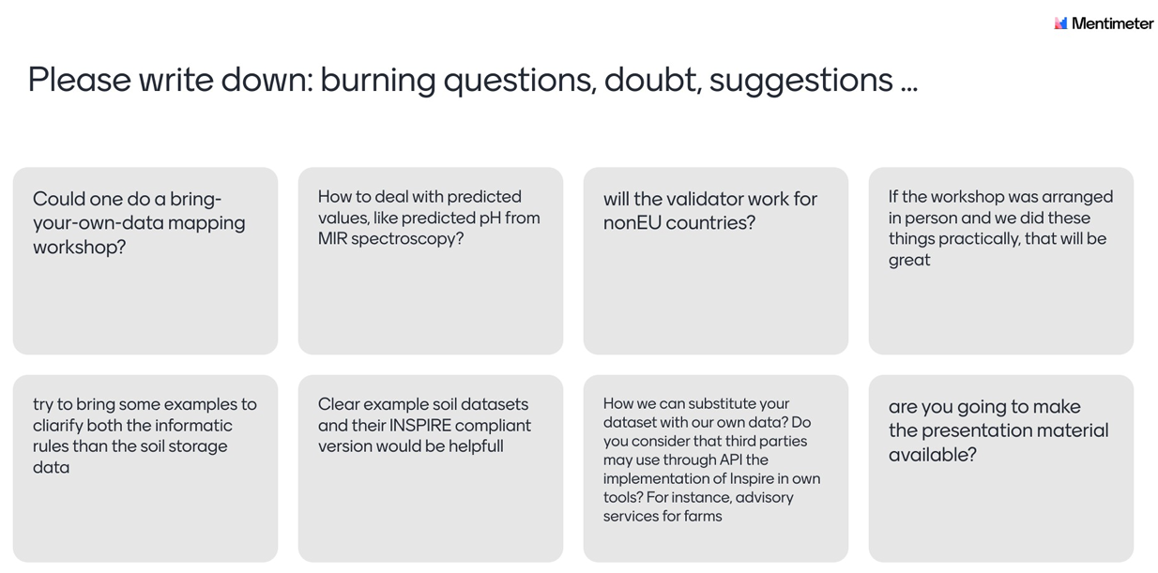

SOME RESULTS FROM THE MENTIMETER AT FIRST WORKSHOP
Examples of input from other datasets at 3° and 4° workshop
It is «just» about
adding MIR process => 4th workshop
YES
Yes, it would be great! Maybe under Soilwise?
Examples of input from other datasets at 3° and 4° workshop
Examples of input from other datasets at 3° and 4° workshop
Reply now
DONE

Slide 7
SUMMARY LESSONS LEARNT AT THE FIRST WORKSHOP
INSPIRE is an EU Directive (Directive 2007/2/EC), aimed at creating an INfrastructure for SPatial Information in EuRopE facilitating the sharing and re-use of data across the EU in support of environmental policy and decision-making.
INSPIRE sets the Implementing Rules (IR) and Technical Guidelines (TG) for the implementation, and a specific technical guideline for Soil Theme exists.
Some simplification of INSPIRE has been allowed to facilitate the implementation, together with a new governance
The INSPIRE Good Practice mechanism is part of this new INSPIRE governance.
Following the INSPIRE implementing rules (IR) the format for data sharing should be GML, but the use GeoPackage encoding has been allowed as a Good Practice.
Developed by OGC as an open format for geospatial information, the “GeoPackage is an open, platform-independent, portable, self-describing, compact format for transferring geospatial information”. A single file can store and handle large numbers of spatial features and related attributes in a relatively small size. It can also store tile matrix sets of imagery, raster maps, tile gridded coverage data, metadata and schema constraints. It is particularly suitable for use in a GIS (desktop) environment.
EJP SOIL has developed a INSPIRE SOIL GEOPACKAGE template, following the approved vector and O&M INSPIRE UML models for Soil, combined with the Sensor Observation Service (SOS) standard.
The EJPSOIL INSPIRE SOIL GEOPACKAGE has been transformed to GML structure and successfully validated inside the INSPIRE validator.
Given the successful validation, the INSPIRE SOIL GEOPACKAGE developed by EJPSOIL can be used as a template by EU Member State for INSPIRE compliant soil data sharing.

Slide 8

The INSPIRE SO GPKG
A Good Practice to facilitate the encoding of soil data in accordance with the INSPIRE Soil Data Specifications
Resume to the INSPIRE-SOIL Geopackage, INSPIRE Soil Geopackage model,
Observation&Measurements (O&M)
Short introduction to Codelists & Ontologies

Slide 9
INSPIRE SOIL Geopackage model structure
Notes:
v.1.1-RC - Release Candidate
GitHub
https://github.com/ejpsoil/inspire_soil_gpkg_template/tree/main
Download GPKG > Version1.1-RC/geopackage/INSPIRE_SO_with_data_and_QGIS_project/INSPIRE_SO.gpkg

Slide 10
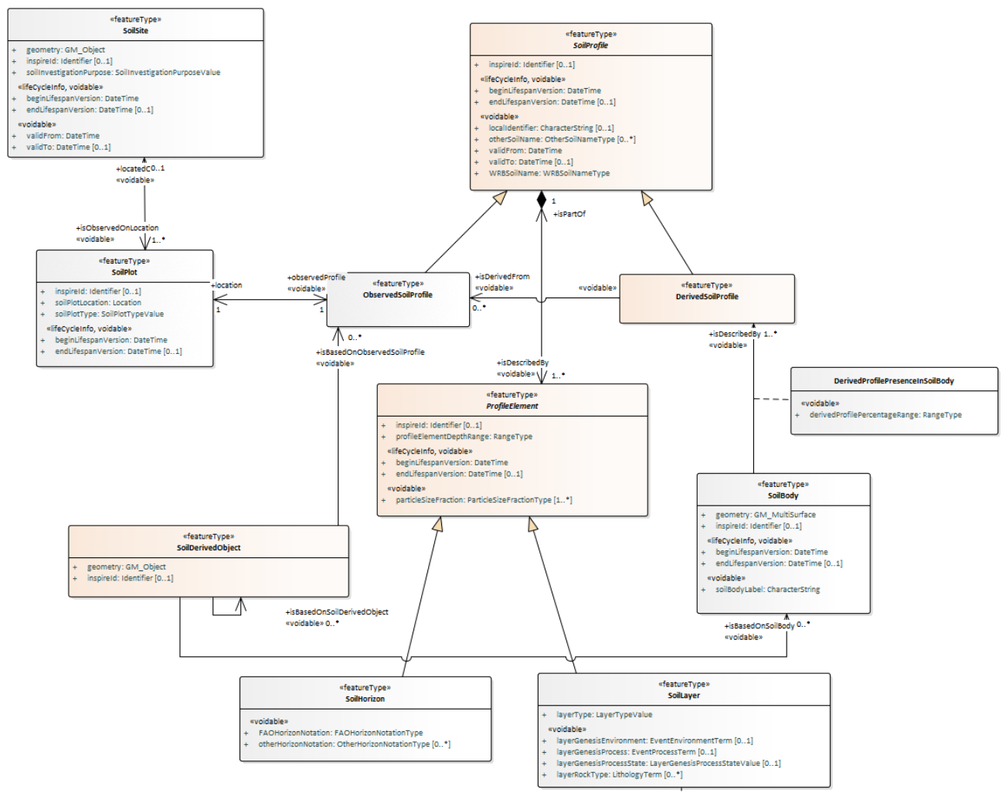
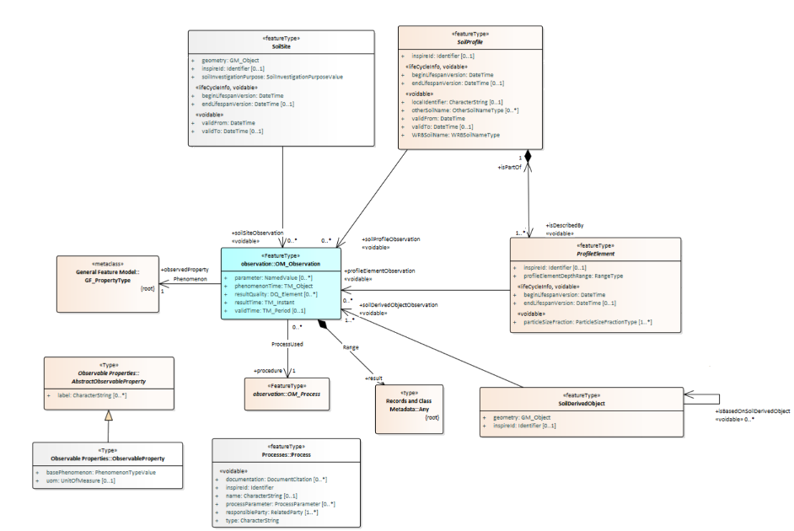
O&M for Soil
Approved INSPIRE UML model for Soil
Vector
https://inspire-mif.github.io/uml-models/approved/html/

Slide 11
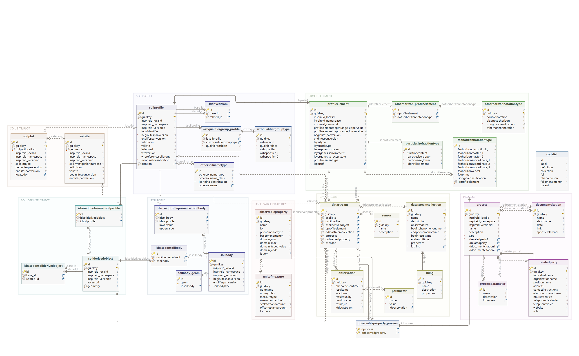

Slide 12
Observation&Measurements (O&M)

Slide 13
ISO 19156:2011 Geographic information – Observations and measurements
Observations and Measurements (O&M) is an international standard which defines a conceptual schema encoding for observations, and for features involved in sampling when making observations.
While the O&M standard was developed in the context of geographic information systems, the model is derived from generic patterns proposed by Fowler and Odell (1997) and is not limited to geospatial information.
O&M is one of the core standards in the OGC Sensor Web Enablement suite, providing the response model for Sensor Observation Service[3] (SOS).
To provide a useful resource for defining architectures for specific applications.
Notes:
Cox, Simon Jonathan David (2011). "ISO 19156:2011 Geographic information – Observations and measurements". International Organization for Standardization. doi:10.13140/2.1.1142.3042. Retrieved 2011-12-20. {{cite journal}}: Cite journal requires |journal= (help)
^ Fowler, Martin (1997). Analysis Patterns: Reusable Object Models. Addison-Wesley. pp. 35–55. ISBN 978-0-201-89542-1.

Slide 14
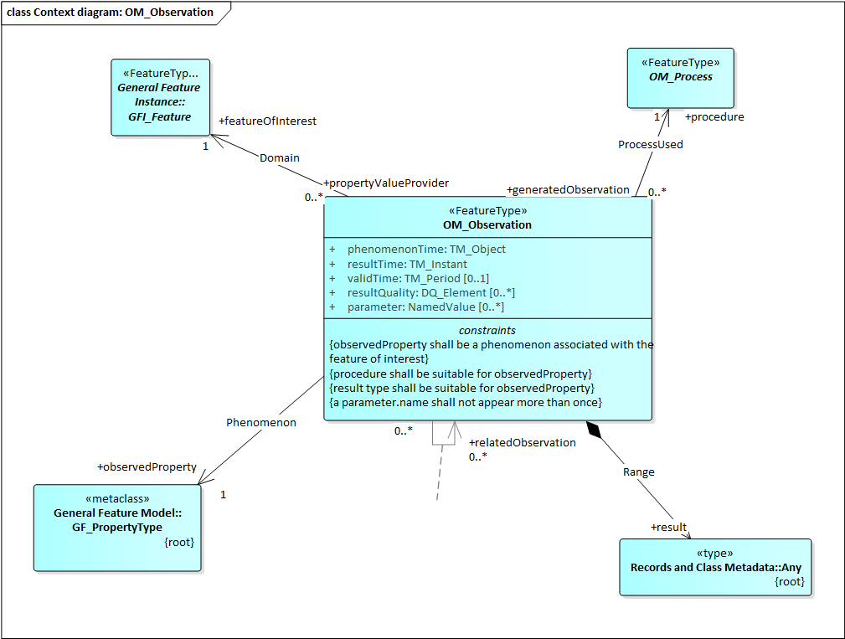
OM_Observation
Observation is closely linked to:
Feature of Interest: real-world object whose properties are under observation
Observed Property: individual property being observed on a feature of interest.
Procedure: action performed on a feature of interest to measure a property.
Unit of measure: the magnitude of a measurement made on a feature using a particular procedure.
Result class provides the actual placeholder for measurement results. The result can be of ‘any’ type.
e.g. Profile element (Soil Horizons or Layers)
e.g. in water
e.g. pH Value
e.g. 7.5
Notes:
O&M defines a core set of properties for an observation:
feature of interest
observed property
result
procedure – the instrument, algorithm or process used (which may be described using SensorML)
phenomenon time – the real-world time associated with the result
result time – the time when the result was generated
valid time – the period during which the result may be used

Slide 15
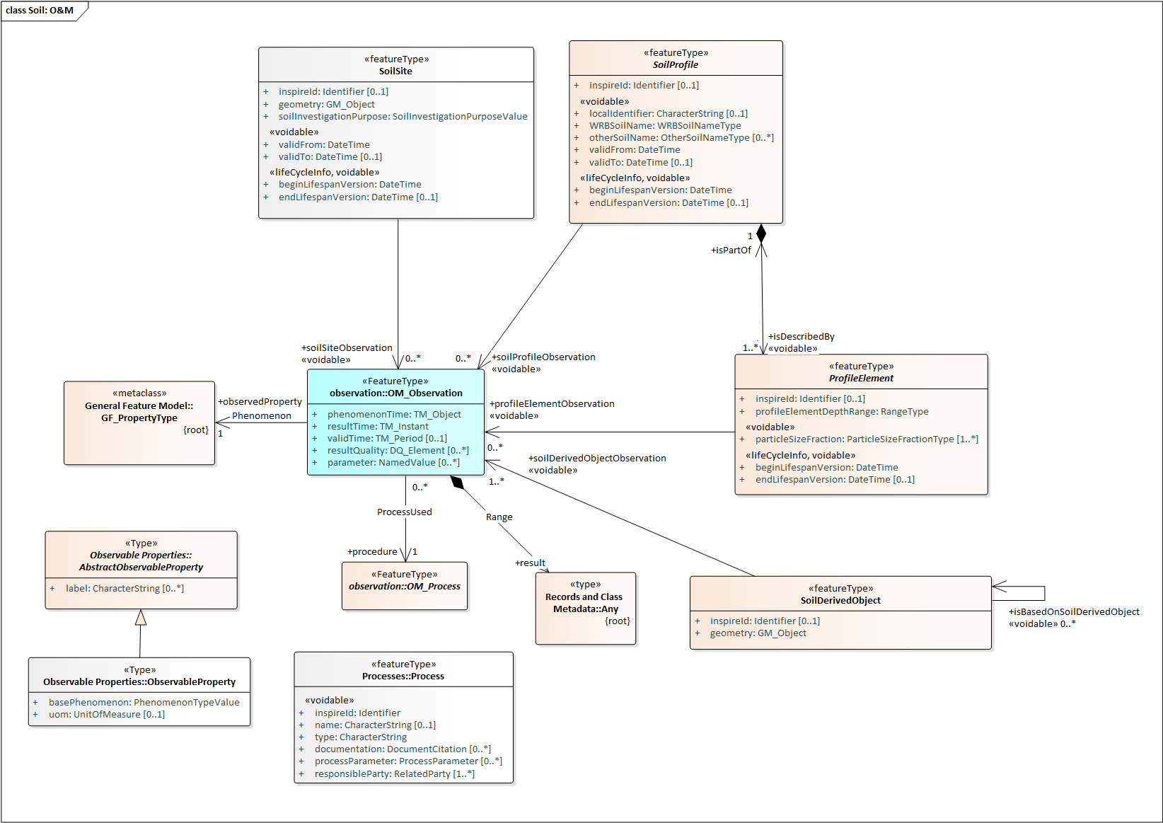
Soil O&M Overview
Feature of interest

Slide 16

Notes:
SOIL SITE/SOILPLOT contiene "l'espessione Geografica del Profilo/Pozzetto/ecc
SOIL PROFILE contiene la tabella SOILPROFILE e tutte le sue tabelle figlie. (c'è un errore lo vedo ora doveva chiamarsi SOIL PROFILE e non SOILPRODILE
PROFILE ELEMENT contiene la tabella PROFILEELEMENT e tutte le sue tabelle figlie.
SOIL DERIVED OBJECT contiene la tabella SOILDERIVEDOBJECT e le tabelle di relazione che servono per definirla in modo corretto.
SOIL BODY contiene la tabella SOILBODY e le tabelle di relazione che servono per definirla in modo corretto.
DATASTREAM contiene tutte le tabelle che servono poer la logica della getsione del valore sia che questo derivi da uno oeesrvazione semplice che da un file di un sensore
OBSERVABLE PROPERTY contiene la tabella OBSERVABLEPROPERTY e tutte le sue tabelle figlie.
PROCESS contiene la tabella PROCESS e tutte le sue tabelle figlie.

Slide 17
Codelists & ontologies
Notes:
Deliverables: https://ejpsoil.eu/knowledge-sharing-platform/deliverables Pag. 111

Slide 18
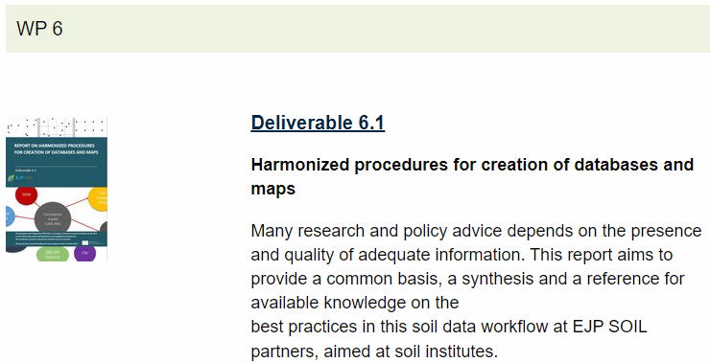
https://ejpsoil.eu/knowledge-sharing-platform/deliverables

Slide 19
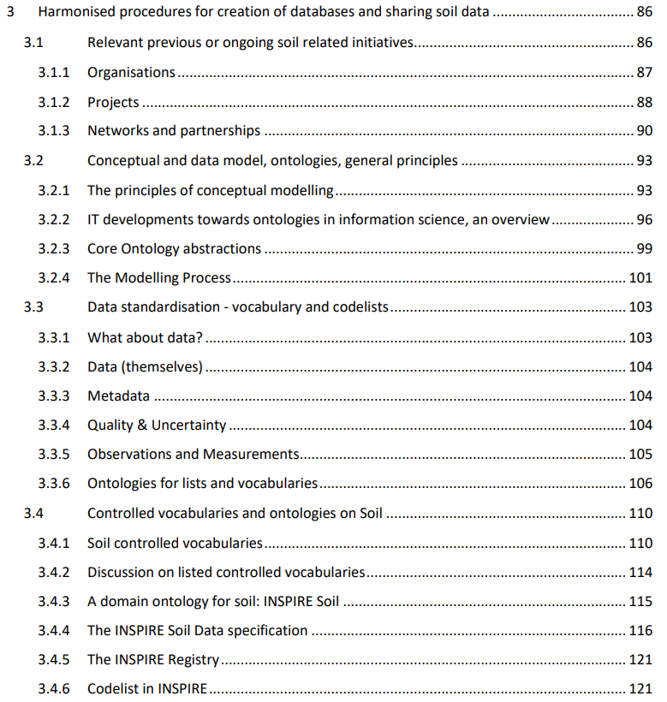

Slide 20
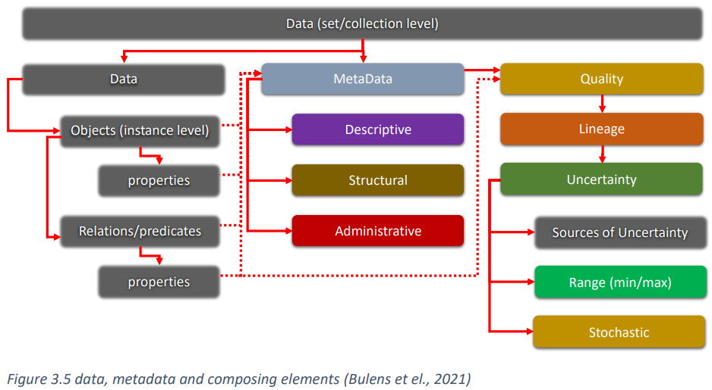
3.3 Data standardisation - vocabulary and codelists
3.3.1 What about data?

Slide 21
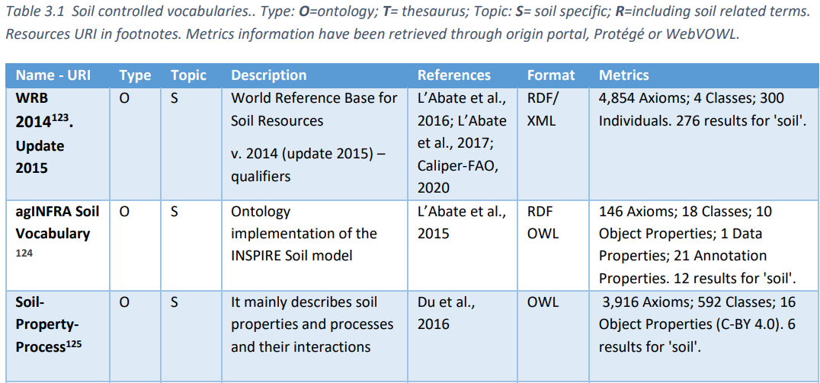
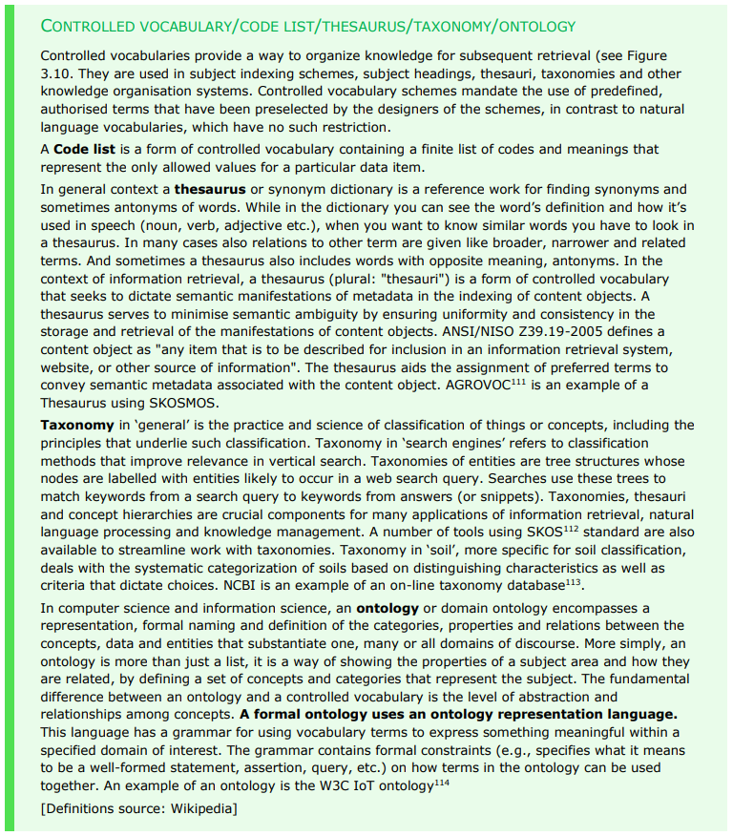
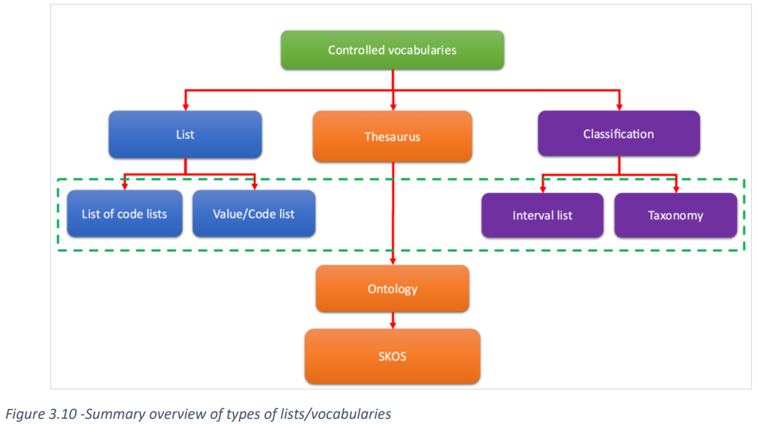

Slide 22
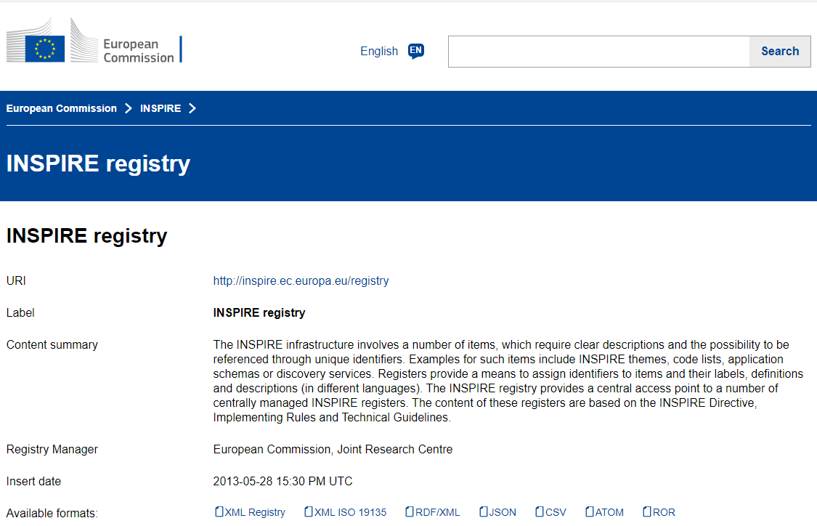

Slide 23
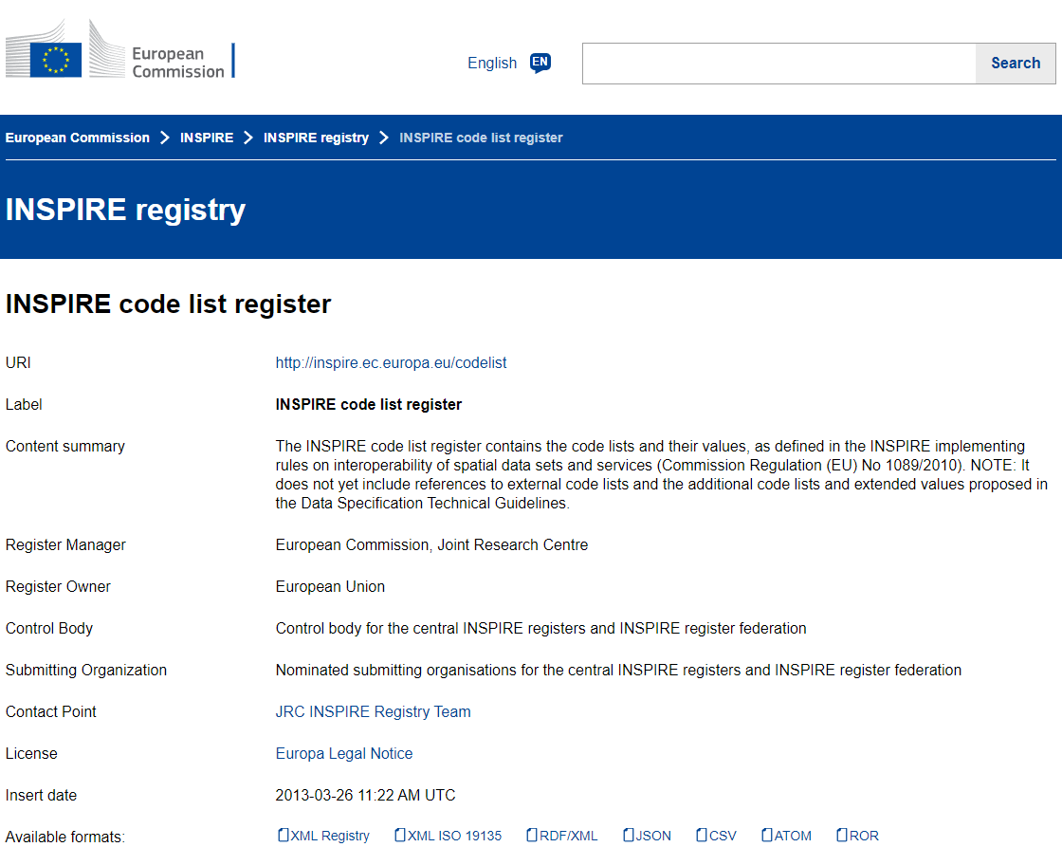

Slide 24
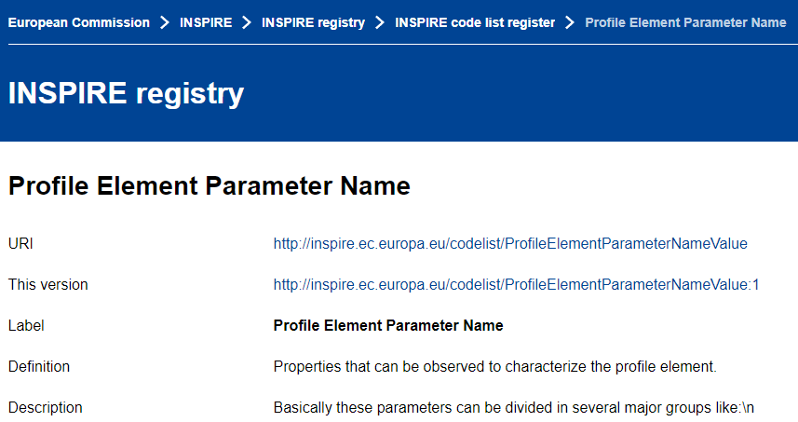
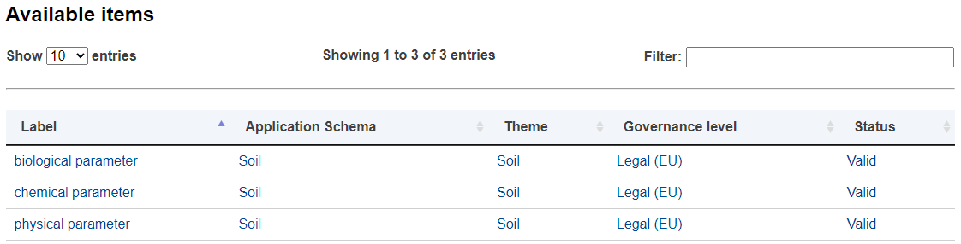

Slide 25

PhenomenoType major groups
https://inspire.ec.europa.eu/codelist/PhenomenonTypeValue
biological
parameter
chemical
parameter
physical
parameter
0
133
0
Soil Site
0
1
3
Soil Profile
0
9
0
Profile Element
Soil Derived Object
0
11
3
Notes:
133: chemical parameter - INSPIRE registry (https://inspire.ec.europa.eu/codelist/SoilSiteParameterNameValue/chemicalParameter)
Contaminated sites

Slide 26
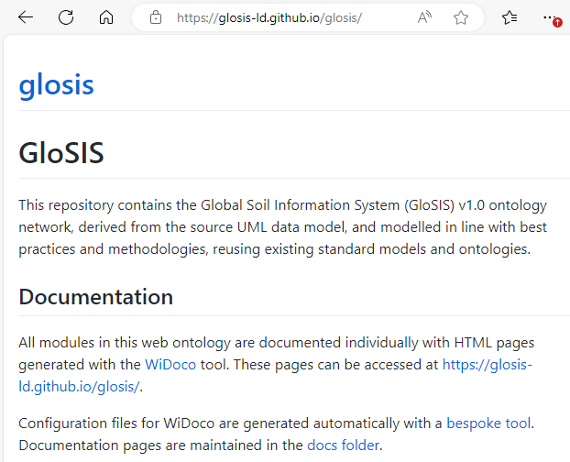
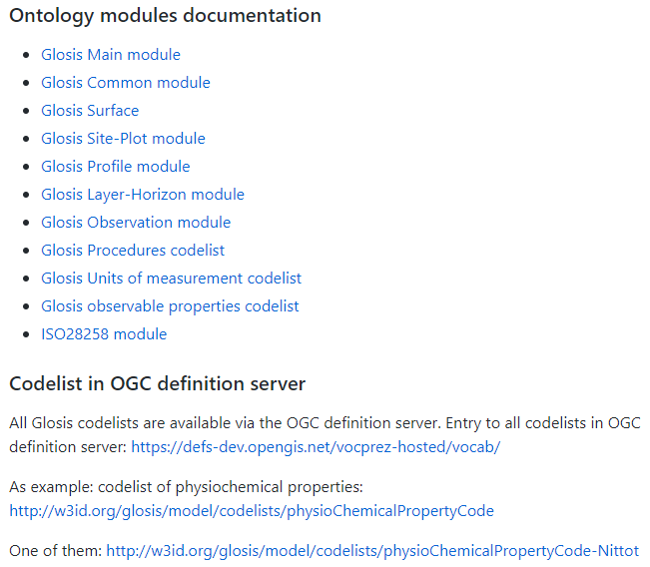

Slide 27
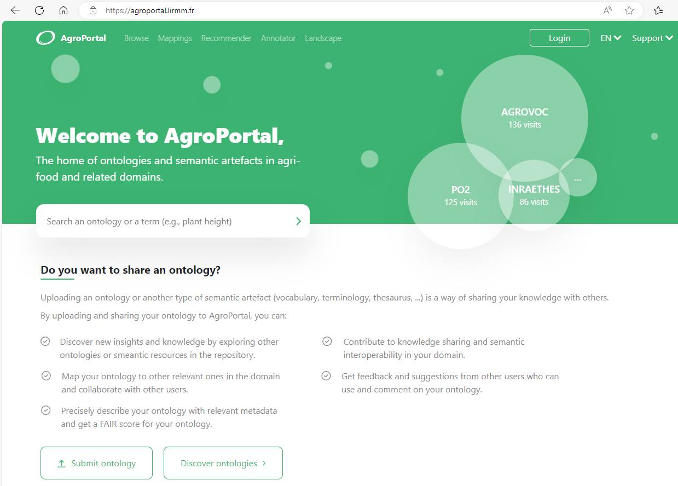

Slide 28
Q&A TIME

Slide 29


Coffeeee…
….tea

Slide 30
Geopackage implementation and extension with LUCAS Topsoil data
Introduction on how to extend the INSPIRE-SOIL Geopackage for the ingestion of a complete dataset. Examples of practical usage for massive data upload.

Slide 31
The LUCAS Topsoil dataset download & data structure

Slide 32
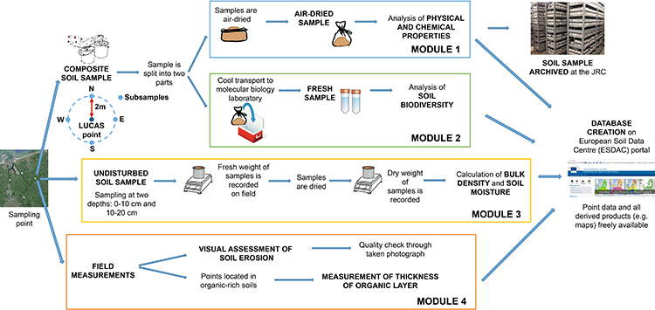
LUCAS: Land Use and Coverage Area frame Survey
Following a decision of the European Parliament, the European Statistical Office (EUROSTAT) in close cooperation with the Directorate General responsible for Agriculture and the technical support of the JRC, is organising regular, harmonised surveys across all Member States to gather information on land cover and land use. This survey is known as LUCAS (Land Use/Cover Area frame statistical Survey). The name reflects the methodology used to collect the information. Estimates of the area occupied by different land use or land cover types are computed on the basis of observations taken at more than 250,000 sample points throughout the EU rather than mapping the entire area under investigation. By repeating the survey every few years, changes to land use can be identified.
LUCAS in Eurostat Website
Land cover/use (LUCAS) Data 2009
Land cover/use (LUCAS) Data 2012
Land cover/use (LUCAS) Data 2015
Land cover/use (LUCAS) Data 2018
Land cover/use LUCAS) Methodology
Notes:
LUCAS - ESDAC - European Commission: https://esdac.jrc.ec.europa.eu/projects/lucas

Slide 33
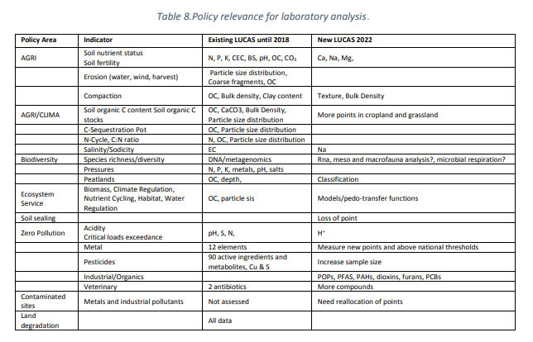
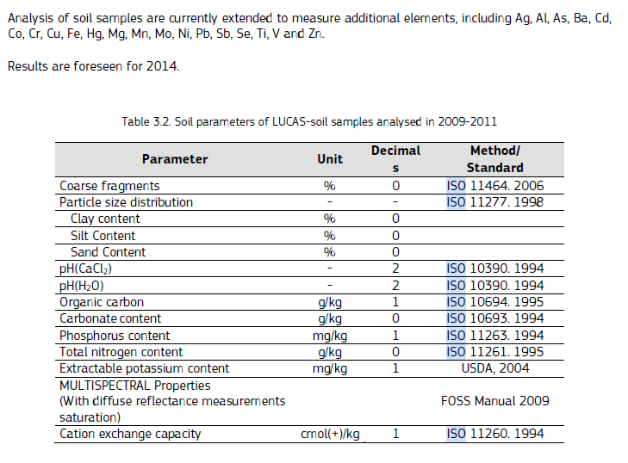
Jones, A, Fernandes-Ugalde, O., Scarpa, S., & Eiselt, B. LUCAS 2022, EUR 30331 EN, Publications Office of the European Union, Luxembourg., 2021, ISBN 978-92-76-21079-5, doi:10.2760/74624, JRC121253
https://publications.jrc.ec.europa.eu/repository/bitstream/JRC121253/JRC121253_01.pdf

Slide 34
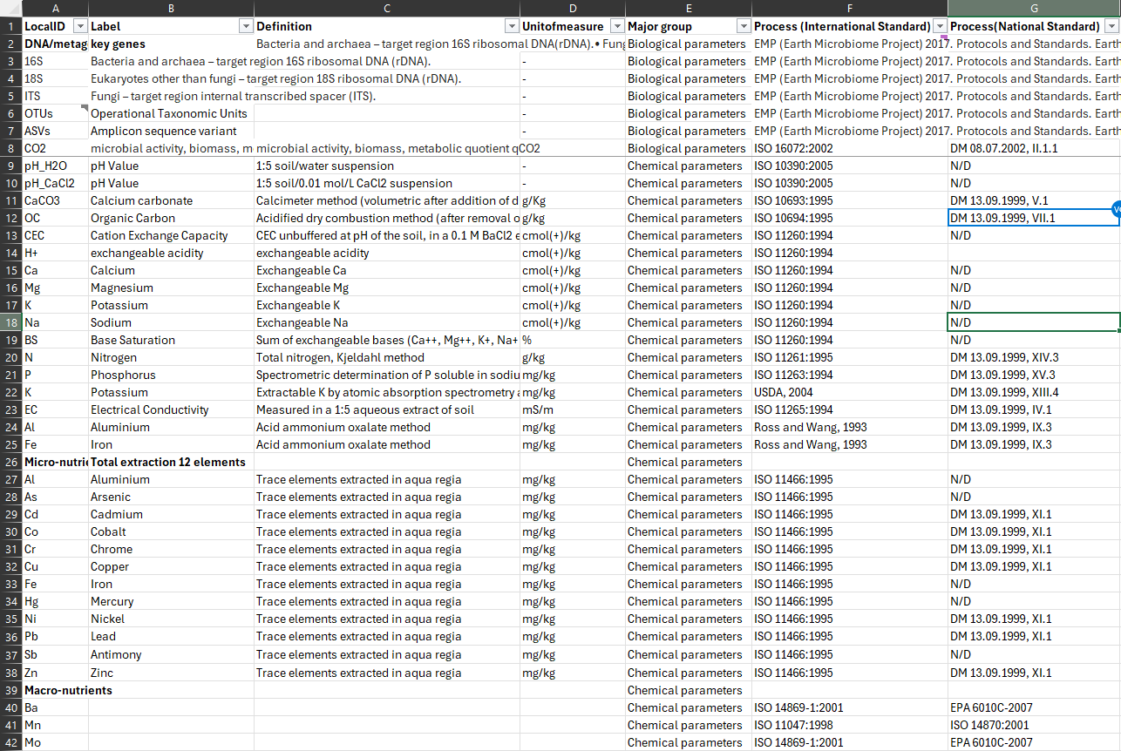

Slide 35
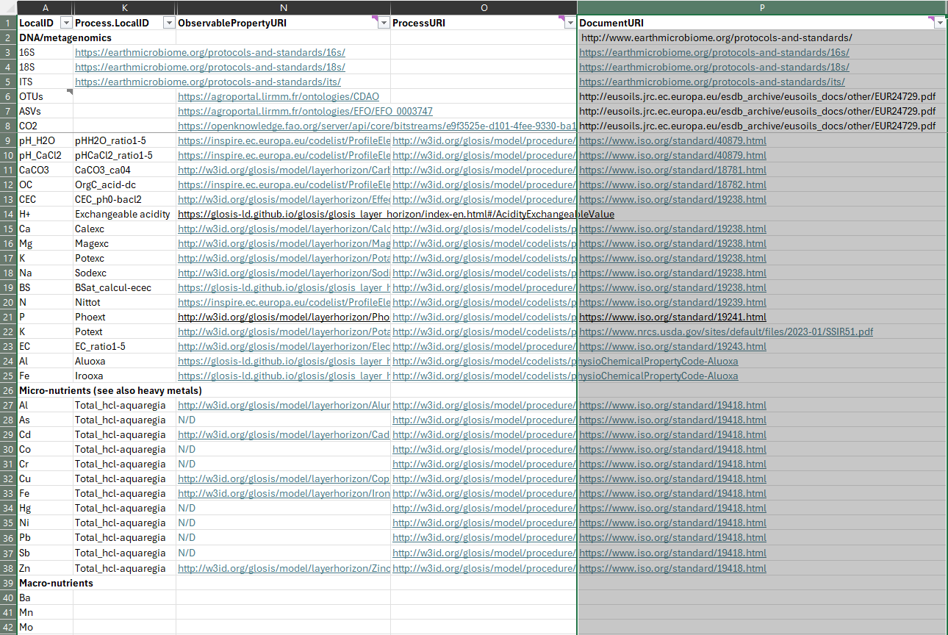

Slide 36

PhenomenonType major groups
https://inspire.ec.europa.eu/codelist/PhenomenonTypeValue
biological
parameter
chemical
parameter
physical
parameter
LUCAS Topsoil Survey
0
0
0
Soil Site
0
0
0
Soil Profile
n
139
8
Profile Element
Soil Derived Object
0
0
0
Notes:
DNA/metagenomics: 16S 18S ITS OTUs ASVs CO2

Slide 37
Population sequence Tables & Properties to be extended prior data ingestion to avoid getting executional errors

Slide 38

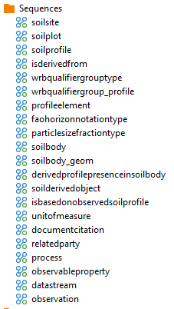
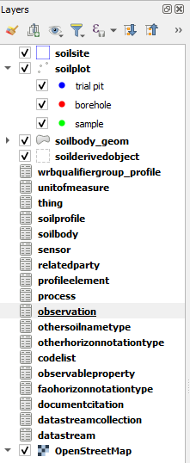
1st
3rd
4th
8th
5th
6th
2nd
7th

Slide 39
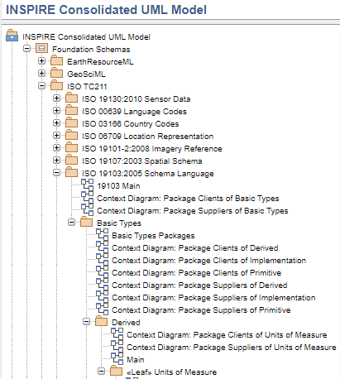
Unit of measure
ISO 19103:2005
Any of the systems devised to measure some physical quantity such distance or area or a system devised to measure such things as the passage of time. The classes of UnitOfMeasure are determined by the member "measureType." Subclasses are not needed for implementation, but their use makes type constraints on measure valued attributes easier to specify. -- conversionToISOstandardUnit is not null only if the conversion is a simple scale
Attribute: uomName; uomSymbol; measureType; nameStandardUnit; scaleToStandardUnit; offsetToStandardUnit; formula

Slide 40
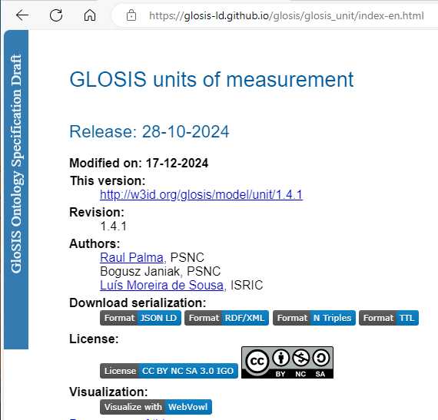
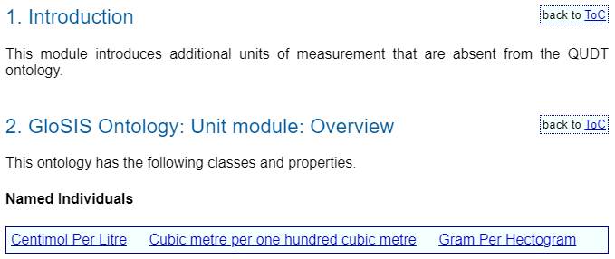

Slide 41
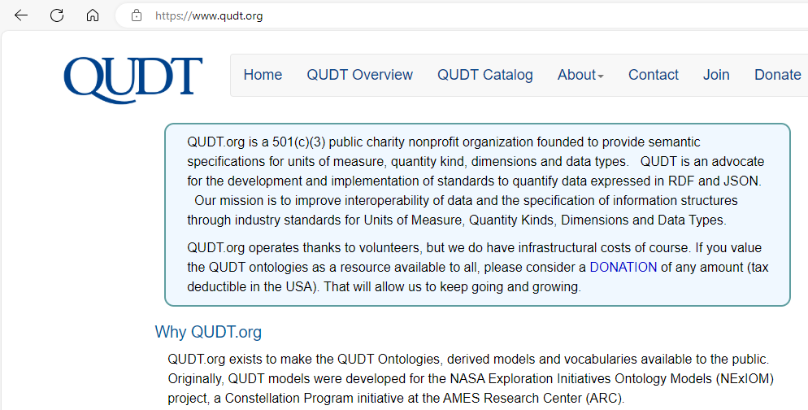

Slide 42
Ontology | Base URI
Main QUDT Ontology | http://qudt.org/2.1/schema/qudt
QUDT Datatype Ontology | http://qudt.org/2.1/schema/datatype
QUDT Units Vocabulary | http://qudt.org/2.1/vocab/unit
QUDT QuantityKinds Vocabulary | http://qudt.org/2.1/vocab/quantitykind
QUDT DimensionVectors Vocabulary | http://qudt.org/2.1/vocab/dimensionvector
QUDT Physical Constants Vocabulary | http://qudt.org/2.1/vocab/constant
QUDT Systems of Units Vocabulary | http://qudt.org/2.1/vocab/sou
QUDT Systems of Quantity Kinds Vocabulary | http://qudt.org/2.1/vocab/soqk

Slide 43
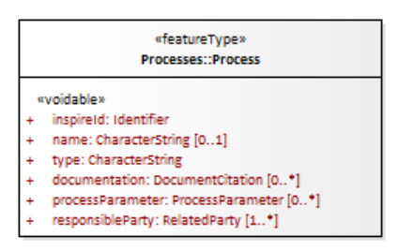
guidkey
inspireid_localid
inspireid_namespace
inspireid_versionid
name
type
Process
Iddocumentcitation1 (FK)
Iddocumentcitation2 (FK)
Processparameter (TABLE)
Idrelatedparty1 (FK)
Idrelatedparty2 (FK)
description
Notes:
Process Type - INSPIRE registry: https://inspire.ec.europa.eu/codelist/ProcessTypeValue

Slide 44
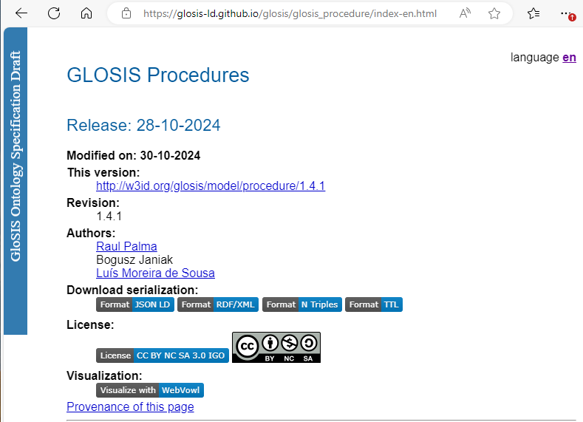
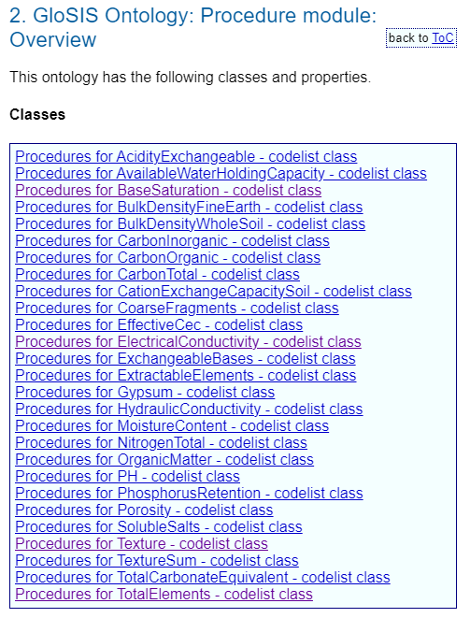

Slide 45

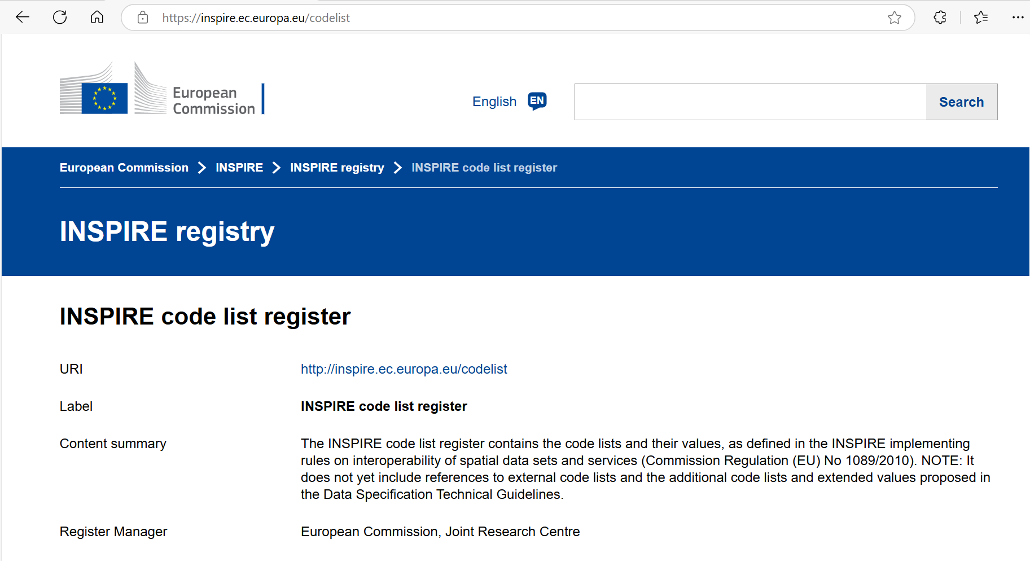
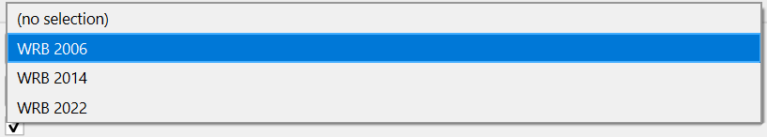
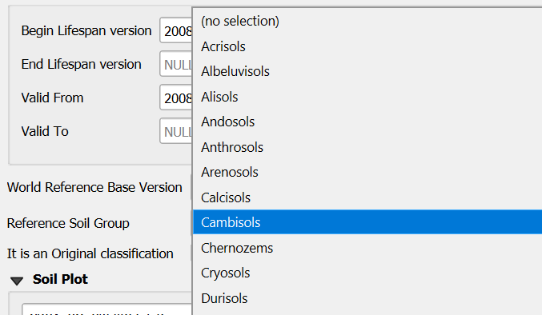
Replicates part of the codelist registry structure, for easy import of lists
CODELIST TABLE
id
The codelists inside the Geopackage allow you to:
label
Through the use of additional system fields in the codelist table, it is possible to implement further form management logic to assist with data entry.
Creating Dropdown Menus in Qgis Forms
definition
collection
parent
Only the values of the Reference Soil Group associated with the selected World Reference Base version are displayed.
Checking the validity of the entered data through the use of triggers.
Notes:
La diapositiva in questione vuole dare una veloce panoramica della Tabella Codelist (che non fa parte del modello INSPIRE), cercando di spiegarne l’utilità all’interno del Geopackage.
E’ animata e divisa pricipalmente in tre parti.
Nella prima facciamo vedere alcuni dei campi della tabella dicendo che replicano alcuni campi della struttura del REGISTRY INSPIRE in modo da facilitarne l’importazione all’interno del Database
Nella seconda iniziamo a spiegare le motivazioni di questa scelta dicendo che grazie a questa tabella è possibile sia creare delle tendine di selezione valori che controllare la corretta immissione del dato anche grazie all’ausilio dei trigger.
La terza ed ultima parte dovrebbe spiegare che all’interno della tabella codelist vi sono altri campi che noi definiamo come di sistema che servono per sviluppare alcune logiche che facilitano l’immissione ed il controllo dei dati, come l’esempio della figura.
La figura ed il relativo testo dovrebbe spiegarci che è possibile nella tendina visualizzata appaiono solo i valori del RSG dell’anno della WRB che abbiamo selezionato nella tendina della WRB version. (va spiegato bene a voce).

Slide 46
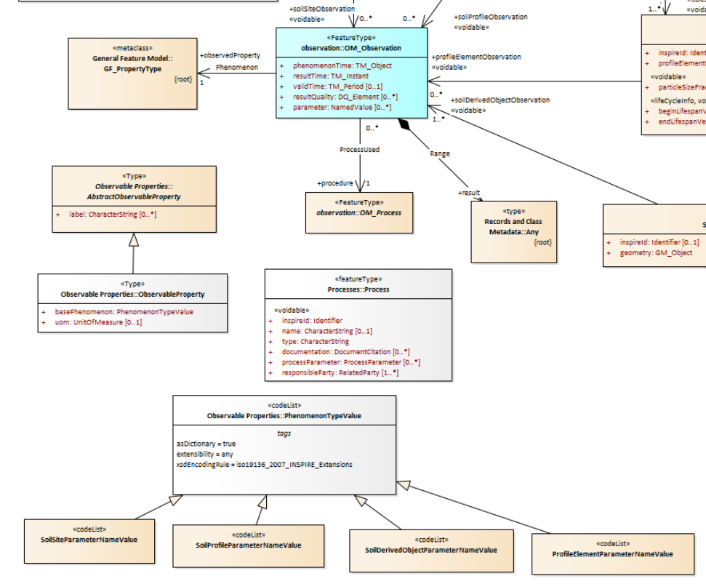
label
basePhenomenon
uom
Observable
Property

Slide 47
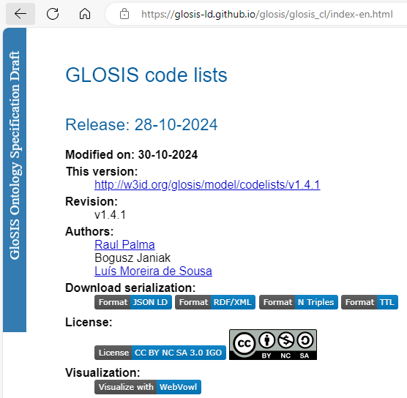
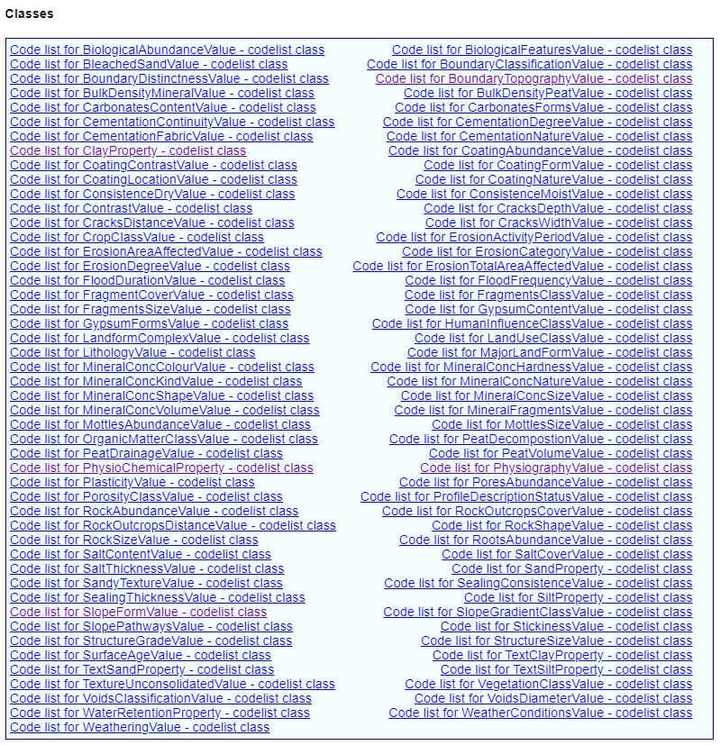

Slide 48
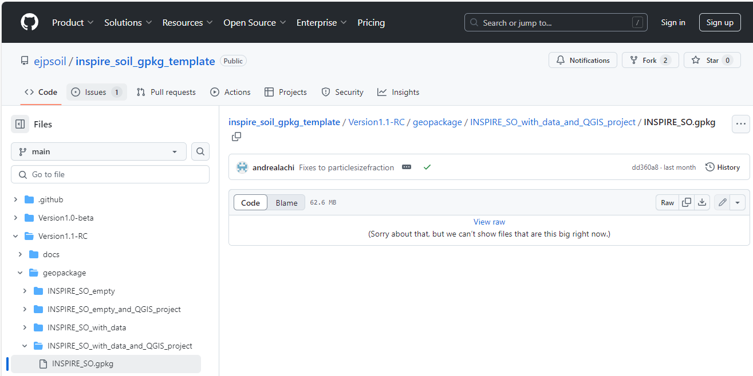
Notes:
INSPIRE_SO_with_data_and_QGIS_project

Slide 49
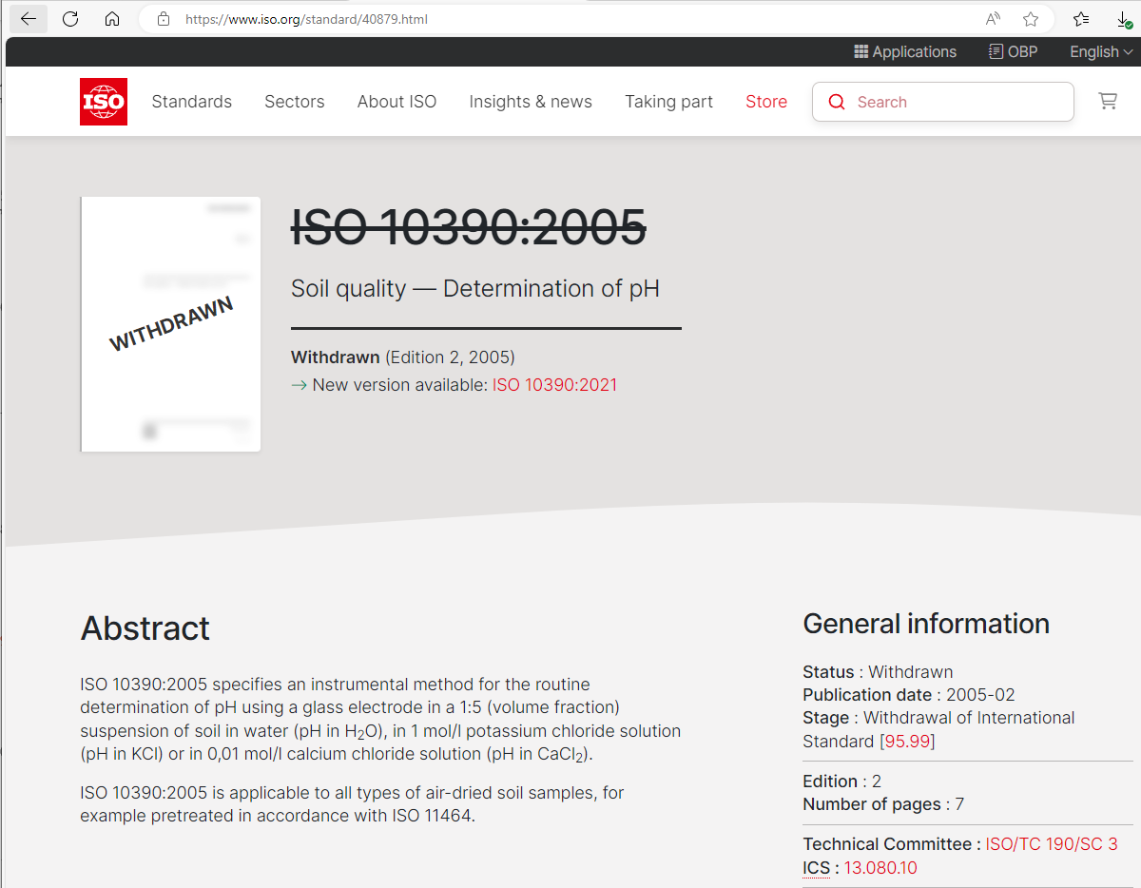
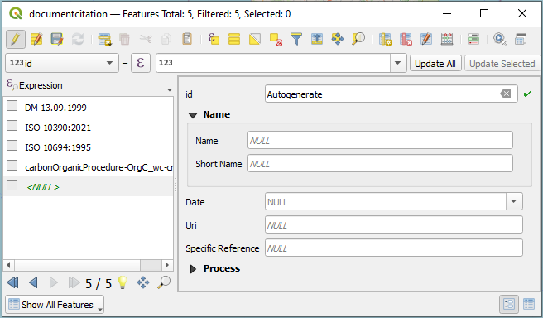
Document citation
URI
Short Name
Name
Date

Slide 50
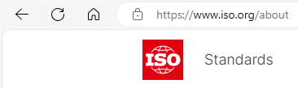
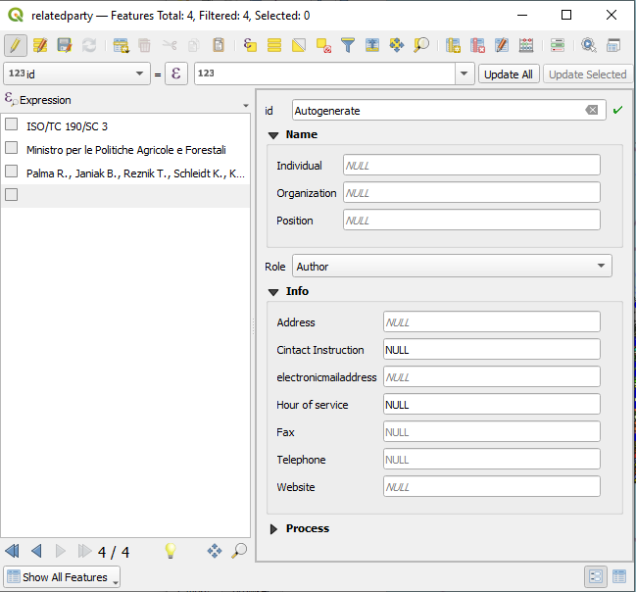
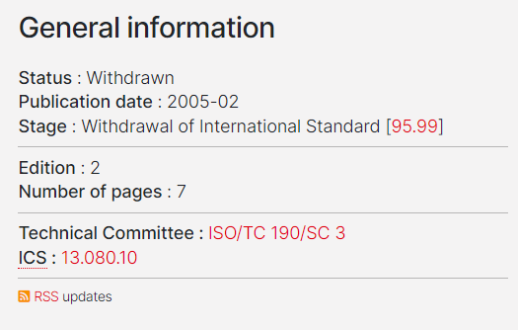

Related party

Slide 51
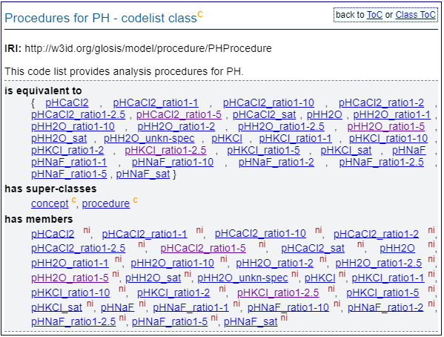
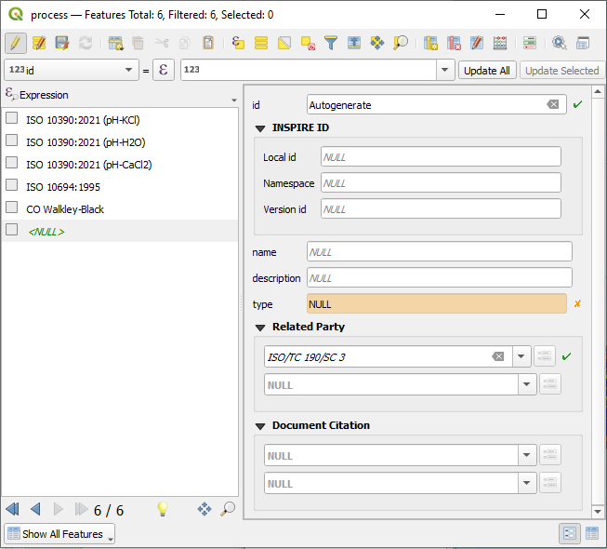
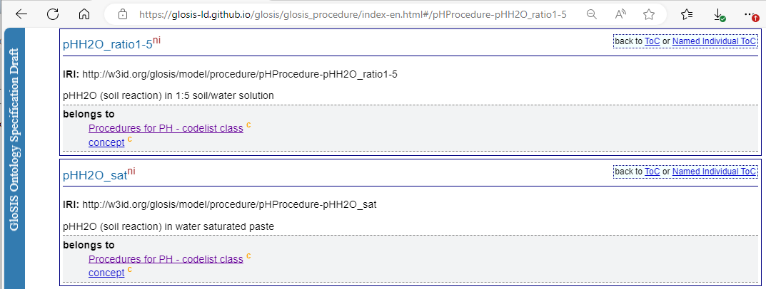
Process
1
Laboratory determination

Slide 52

Codelist
ProfileElementParameterNameValue
profileelement
chemical
profileelementchemical

Slide 53


Observable property
profileelement
chemical
cmol(+)/kg
result_value

Slide 54
Online demonstration …
Notes:
Passi per caricamento progetto in Qgis
Navigatore Database (oggetti); Diagramma ER
Tabelle > SoilProfile: Dati e Diagramma; Colonne; Chiavi; Indici; Referenze; Trigger
SQL Example:
WITH MaxDepthPerProfile AS ( SELECT pe.ispartof AS soilprofile_guidkey, sp.wrbreferencesoilgroup, MAX(pe.profileelementdepthrange_lowervalue) AS max_depth FROM profileelement pe INNER JOIN faohorizonnotationtype fn ON pe.guidkey = fn.idprofileelement INNER JOIN soilprofile sp ON pe.ispartof = sp.guidkey WHERE fn.faohorizonmaster_1 != "http://inspire.ec.europa.eu/codelist/FAOHorizonMasterValue/R" GROUP BY pe.ispartof, sp.wrbreferencesoilgroup ) SELECT wrbreferencesoilgroup, ROUND(AVG(max_depth), 2)AS average_max_depth FROM MaxDepthPerProfile GROUP BY wrbreferencesoilgroup;

Slide 55





FOI, Datastream & Observation
INSPIRE_SO_template
Custom Soil Database
</>
</>
STYLES
Portable
Server

Slide 56

How to share Halestudio transformation projects

Slide 57


MENTI & Q&A TIME
https://www.menti.com/alqwxtofjt6f
Thanks for your attention!
Recordings will be available on EJPSOIL YouTube channel https://www.youtube.com/@ejpsoil6391
The presentation will be shared on the EJP SOIL website https://ejpsoil.eu/soil-research/soil-data-monitoring-mapping-and-modelling
For questions: andrea.lachi@crea.gov.it, s.morrone@epsilon-italia.it maria.fantappie@crea.gov.it, giovanni.labate@crea.gov.it

Slide 58
Connect to Geopackage

Slide 59
Connect to Geopackage R script library(RSQLite) library(gpkg) My_Geop <- gpkg_list_tables("C:/Users/… /Geopackage/INSPIRE_SO.gpkg") Python script import sqlite3 conn = sqlite3.connect("C:/Users/… /Geopackage/INSPIRE_SO.gpkg") conn.close()

Slide 60




Connect to Geopackage
Python script
R script
library(RSQLite)
library(gpkg)
My_Geop <-gpkg_list_tables("C:/.../INSPIRE_SO.gpkg")
import sqlite3
gpkg_path = "C.../INSPIRE_SO.gpkg"

Slide 61
(HALE studio transformation)

Slide 62
Work in progress
create.sql
create_PostGis.sql
</>
</>
STYLES
Portable
Server

Slide 63

How to use the HALE Studio Project
Open The “GPKG-to-GML” Hale Studio Project
Import the Geopackage Data
Export the GML

